Slide 1

Analysis of the Sale Properties
of Housing.com

Slide 2
About me
Name: S. Reddy Kishore
Degree: B.Tech (CAI)
College: MITS Autonomous College
Hello, my name is Reddy Kishore Seethi. I am a B.Tech graduated student in the stream of Computer Science and Artificial intelligence department at Mits college. As a B.Tech graduated student in Computer Science and Artificial Intelligence, I am driven by a keen interest in programming and data science. My technical proficiency spans Python, SQL, data analysis, and web scraping, complemented by hands-on experience with Pandas, NumPy, Matplotlib, Seaborn and Webscraping for robust data manipulation and visualization. My current training programme at Innomatics Research Labs further strengthens my ability to work with real-world datasets and contribute to dynamic, innovative projects. I am a quick and enthusiastic learner, eager to apply my problem-solving skills to data-driven challenges.

Slide 3
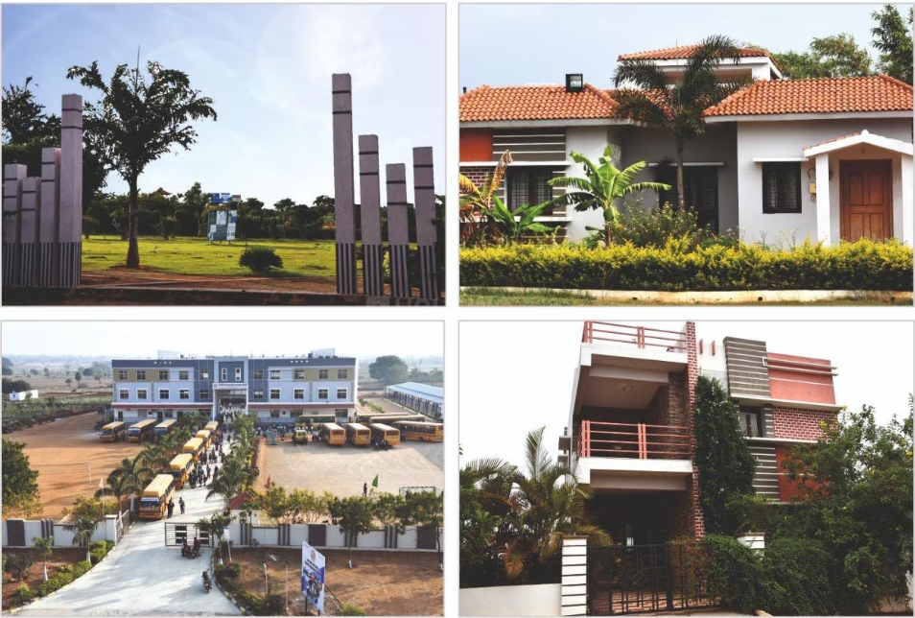
CaseStudy:
This case study analyzes residential properties on Housing.com, with data collected via web scraping. The objective is to extract key attributes—price, type, size, and BHK configuration—and perform Exploratory Data Analysis (EDA). This process identifies crucial market patterns, pricing trends, and property demand across different Hyderabad neighborhoods, providing valuable, data-driven insights for homebuyers, investors, and real estate developers.

Slide 4
Data Acquisition Using Web Scraping:
Data was extracted from the Housing.com website using web scraping techniques.
Python and BeautifulSoup library were used to parse HTML content.
Scraped key product attributes such as:
Price
BHK
Size
Delivery date
Type
Used requests library to fetch HTML pages.
Implemented pagination handling to collect data from multiple listing pages.
Extracted over 500+ property entries from various Hyderabad locations.
Stored the scraped data in a structured Pandas DataFrame for subsequent analysis.

Slide 5
Creating the DataFrame
The Collected raw data was organized into lists, with each list corresponding to a specific property attribute (e.g.Name, Type, price, BHK,etc.).
Used Pandas library to combine these lists into a single, structured DataFrame.
Previewed the newly created DataFrame using df.head() for initial inspection to verify its structure and ensure the data was loaded correctly
Exporting to CSV
Final DataFrame was exported using to_csv() function.
File saved as “hyderabad_real_estate.csv" for further analysis.

Slide 6
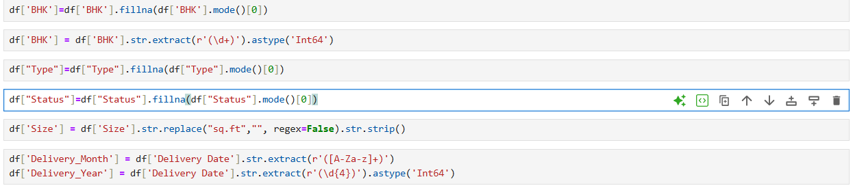
Data-Cleaning:
Checked and removed duplicate property listings to ensure data uniqueness.
Handled critical missing values in columns like Price and Size.
Standardized the Price column into a single numerical format (Rupees).
Cleaned and converted BHK and Size columns to numerical types.
Verified the final dataset's structure and data types for consistency.

Slide 7
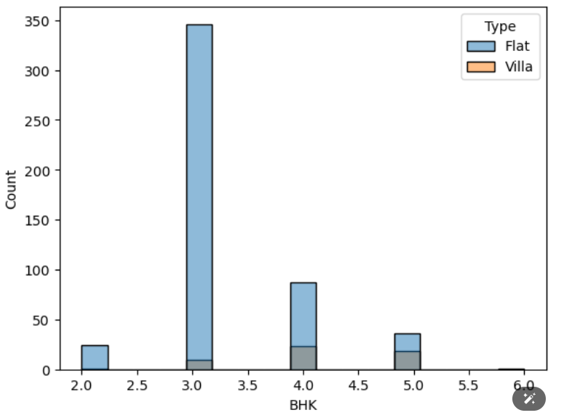
VISUALIZATION and INSIGHTS
Flats and Villas available based on BHKS(Histogram)
As you can see from the 2BHK, properties are mostly Flats shows 2BHKS are not ideal for villas and from the tallest bar, 3 BHK properties are the most numerous, and almost all of them are Flats.
As you move to larger sizes like 4 and 5 BHK, Villas become more common, but Flats still make up the majority of listings.
For the largest properties (6 BHK), the listings are primarily Villas, indicating they are the standard for high-end, spacious homes

Slide 8
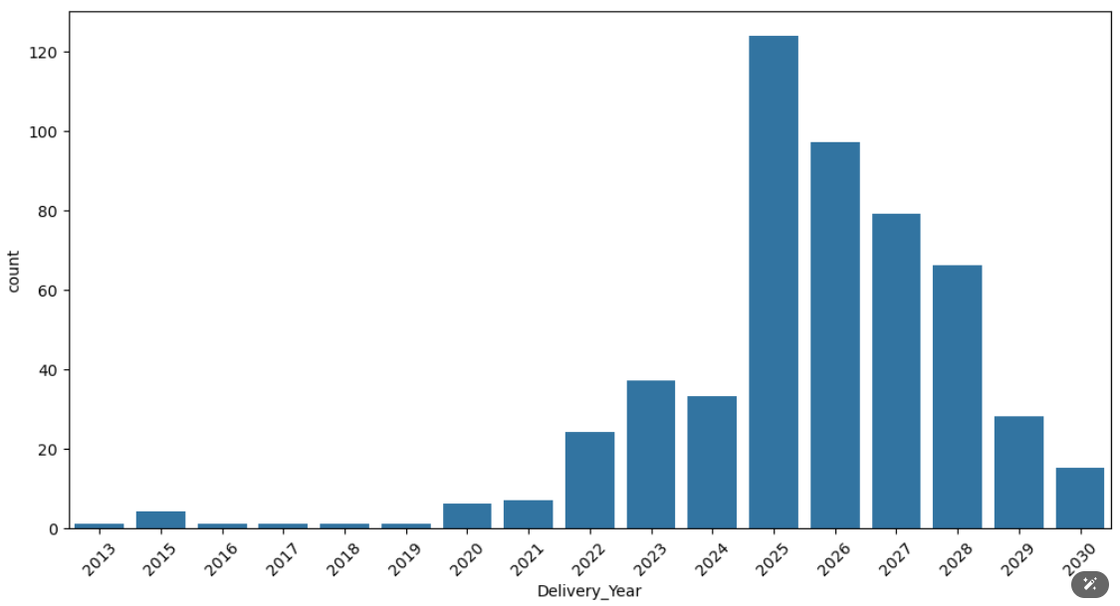
No. Of Properties delivered on each year (Count plot)
2025 is the peak year for scheduled property deliveries. This suggests a massive wave of new housing supply is set to become available in the current year, likely from projects that were launched several years ago.
When you see a property listed with a delivery date that has already passed, it usually means one of two things:
The property is still under construction, and the original, missed deadline is still showing in the data.
The property is finished and was delivered on time, but it remains unsold on the market may be because of several reasons like pricing.
A project with a 2030 delivery date is likely a massive township or a multi-tower complex that will be built in phases over many years.

Slide 9
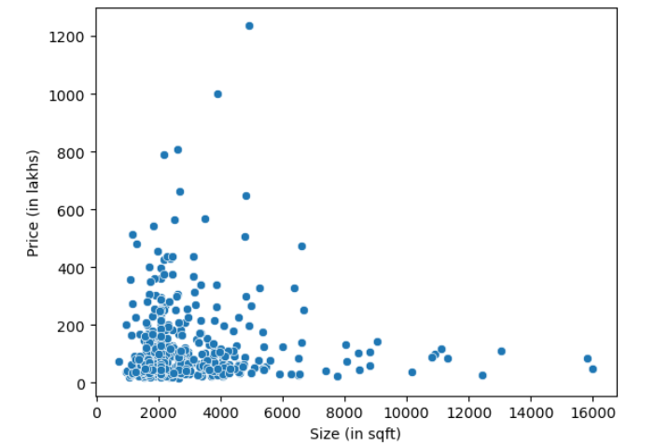
Offer Price by Gift Tag
Generally, as the size of a property increases, its price also tends to increase.
The plot clearly shows luxury outliers—properties that are very expensive for their size.
However, the largest properties are not always the most expensive on the market.
This proves that location and luxury are just as critical as size in determining a property's value.

Slide 10
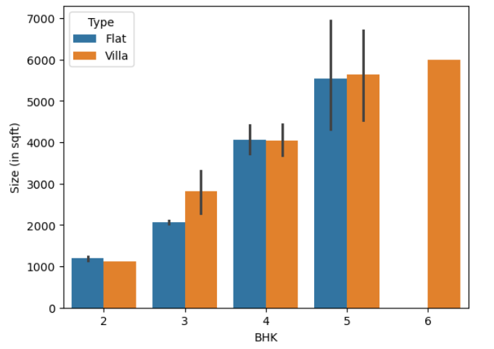
Size distribution based on BHK (Bar Plot)
This chart compares the average size (in square feet) of properties based on their BHK configuration and whether they are a "Flat" or a "Villa.“
As expected, for both flats and villas, the average size of the property directly increases with the number of bedrooms (BHK) increase. This shows a clear, logical progression from smaller 2 BHKs to very large 5 and 6 BHK properties.
For properties with 3 or more bedrooms, villas are larger than flats with the same BHK configuration, where villas are significantly more spacious than flats. This trend suggests that buyers looking for more space tend to prefer villas.
The chart shows that 6 BHK properties in your dataset are exclusively villas. This strongly indicates that the market for very large, high-end residential properties (6+ bedrooms) is almost entirely composed of standalone villas rather than apartments.
Interestingly, in the 2 BHK category, the trend is reversed. The average 2 BHK flat is slightly larger than the average 2 BHK villa. This might suggest that 2 BHK villas are a niche market, while 2 BHK flats are built to a more standard, slightly larger size.

Slide 11
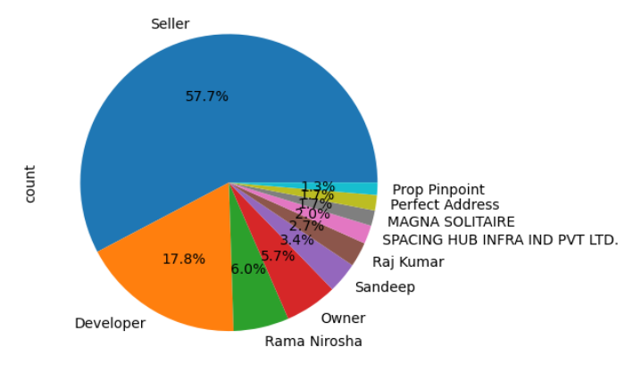
Properties listed for sale by each category(Pie Chart)
Market Dominance: The two largest slices, Seller (57.7%) and Developer (17.8%), control the vast majority of the market. This indicates that most properties are not sold directly by an owner but are managed through professional channels like real estate agents, brokers, or directly by construction companies.
High Fragmentation: After the top two categories, the market becomes highly fragmented. No single named company or individual holds significant power. The largest specific lister, "Rama Nirosha," has only a 6% share, followed by a long tail of smaller players with less than 5% each.
Actionable Conclusion: This shows that the real competition for listings is happening within the large, anonymous "Seller" category. For a homebuyer, it means they are most likely twith a professional agent or a developer's sales team.

Slide 12
Conclusion:
The Market Standard: 3 BHK flats are the most common property type available, representing the core of the Hyderabad housing market.
What Drives Value: Location is the primary driver of price. Premium neighborhoods and luxury amenities command significantly higher prices, often more so than just the size of the property.
Future Supply: A major wave of new properties is scheduled for delivery in 2025, which is expected to increase housing options and competition among sellers.
Who is Selling: The market is dominated by professionals, with over 75% of listings managed by real estate agents ("Sellers") and developers rather than direct owners.
The Premium Market is Defined by Villas: For homes with three or more bedrooms, villas consistently offer more square footage than flats. This clearly defines them as the preferred property type for buyers seeking larger, more spacious, and premium living options.

Slide 13

THANK YOU

